Slide 1
WP4
Testing
Axel Luyten (presentation) & Alberto Castro (minutes)
30 Jan 2024

Slide 2
Agenda
Why we test
What to test: calculation pathways
How we test
DEMO adding a test
Discussion: Who tests what
Timeline

Slide 3
Why we test
We test to make sure that
the functions work properly (no errors & warning messages, output layout as expected, …)
the calculation results of the different pathways are correct

Slide 4
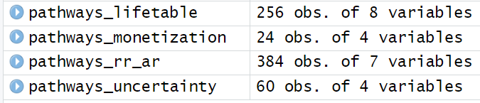
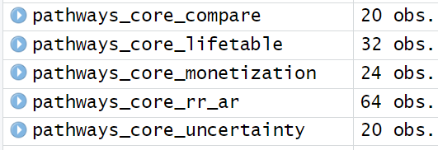
What we test
All theoretically possible pathways several thousand
All relevant pathways
All core pathways
~ 700 (x 2 for compare() )
~ 160 (estimate)

Slide 5
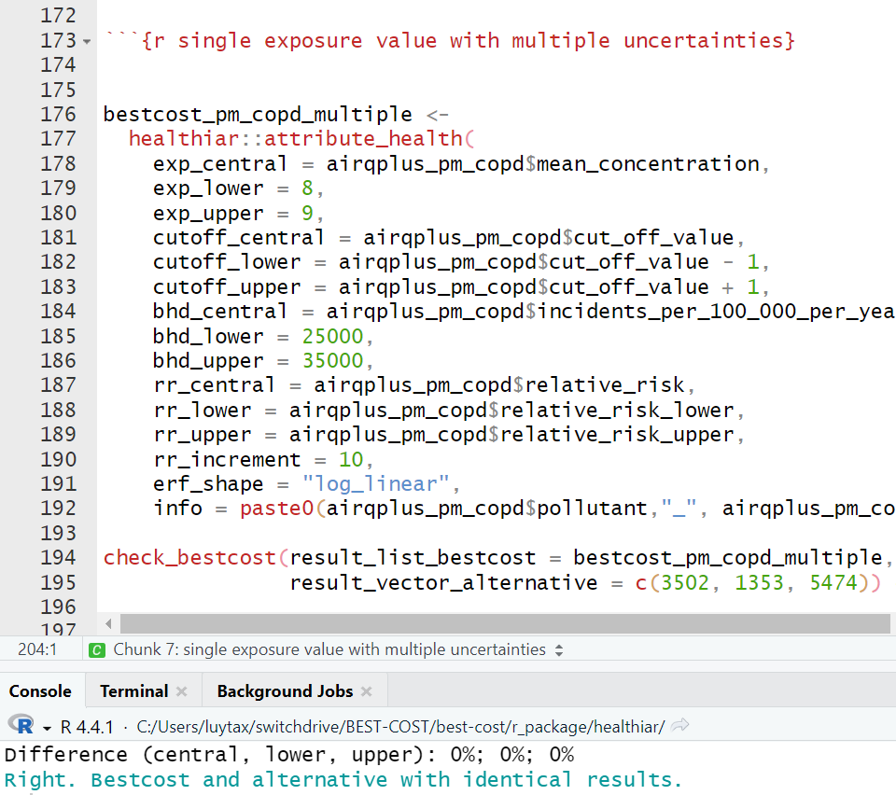
How we test (1)
Before: R markdown with test cases, which was a “home-made” (short-term) solution:
Call function
Compare results to comparison study/previous values
Print output
1
2
3

Slide 6
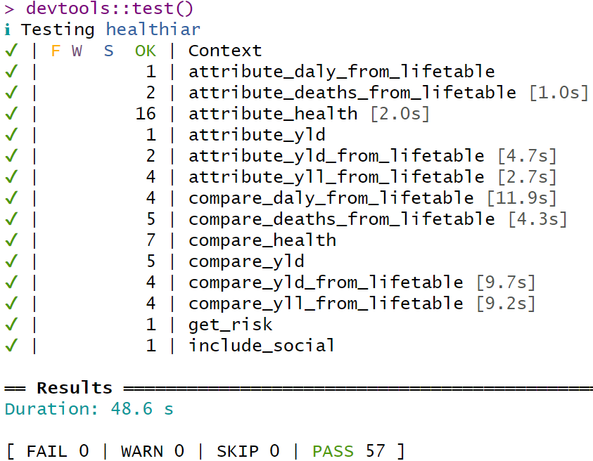
How we test (2)
After: Unit testing using R package test_that
More professional, standard and systematic approach
One script for each package function containing all tests of that function
Results from healthiar are compared with the expected results
devtools::test() checks all at once
83
BUT of these many only compared to PREVIOUS results, NOT compared to EXTERNAL study / assessment

Slide 7
How we test (3): adding a new test
Pick a pathway
Look for comparison assessment*
Fill out the function template with the assessment input data
Check whether results of healthiar and your chose assessment are the same
Upload the test to Teams / GitHub
* Possible sources, in order of decreasing preference: 1) own assessment; 2) other studies / reports; 3) artificial intelligence, e.g. ChatGPT; 4) use “fake” (but realistic) input data, to make sure calculation works (no error) and that results don’t change over time

Slide 8
DEMO adding a new test
Pick a pathway
Look for comparison assessment
Fill out the function template with the assessment input data
Check whether results of healthiar and your chose assessment are the same
Upload the test to Teams / GitHub
Relative risk; log-linear ERF shape; exposure distribution; with cutoff; no iteration, no input variable uncertainty
example_road_noise_niph
→ R Markdown ADD_NAME
Yes!
Teams folder: ADD LINK

Slide 9
Discussion: Who tests what
Proposal:
Relative risk: Sciensano, TAI, CSTB (SPF), LMU
Absolute risk: NIPH
Iteration: Swiss TPH, Sciensano, JRC (Enrico?)
Social analysis: Sciensano
Summary uncertainty: (Sciensano), Swiss TPH
Monetization: UP
Lifetable: Swiss TPH, UBD-Policy (?), LMU (?)
Multipollutant: LMU
Prepare function: Sciensano, Swiss TPH, WP3? (MDI function), JRC (Enrico?)
Internal functions: Swiss TPH
Other aspects: summary uncertainty, prepare functions, … to be decided

Slide 10
Timeline
Next steps:
Everyone adds at least one test until the next Nerd meeting (March 3rd 2025) to …
… get familiar with the process
… be able to exchange experiences during the meeting
Hard deadline:
Cover core calculation pathways by the end of June, before the external workshop(s)

Slide 11
Happy testing! : )

